Slide 1
Introduction to Python
Eddy
eddyhu71@gmail.com
https://github.com/EddyHu71
https://www.linkedin.com/in/eddy-0bb67a11b/

Slide 2
What is Python?

Slide 3
Developed in 1990
High Level Language.
Interpreter

Slide 4

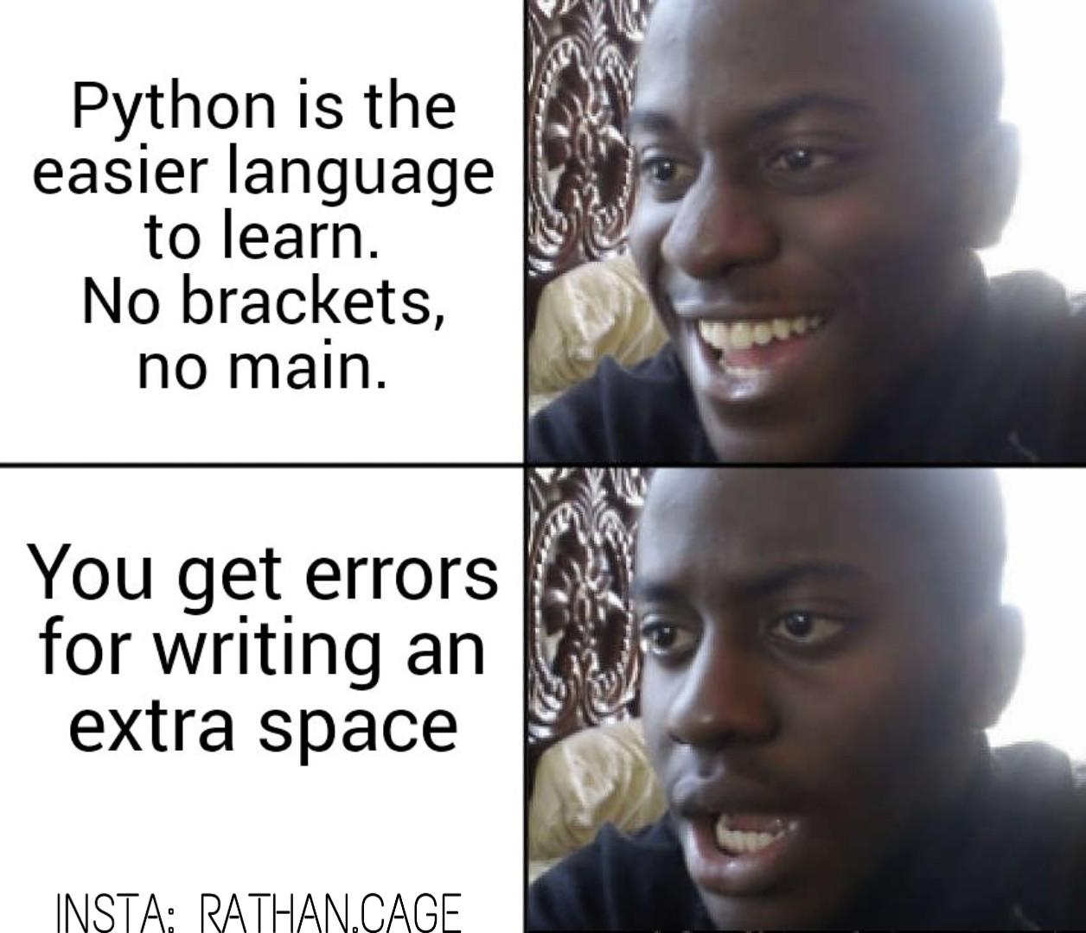
https://www.reddit.com/r/ProgrammerHumor/comments/ax9s4h/python/
https://www.reddit.com/r/ProgrammerHumor/comments/bwehje/python_ftw/

Slide 5
Variables, String and Numbers

Slide 6
What isVariables, String dan Numbers?
1. Variables
A value that stored in memory
2. String
A bunch of character or numbers
3. Numbers
Number can we use to operate

Slide 7
How to declare a variable
The first character must be underline character (_), words or capital.
Not allowed to use reserved word from Python.
Not allowed to use number for the first character.
Case sensitive based.
Example :
_first= 10, First = 20, first = 30, thefirst = “first”

Slide 8
Input/Output

Slide 9
For output of the python, we can use print keyword.
Syntax:
print(“Statement”) atau print(‘Statement’)
For the input of the python, we can use input keyword.
Syntax:
input(“statement”) atau variable = input(“Statement”)

Slide 10
Decision Making

Slide 11
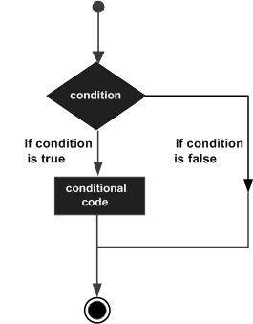

Slide 12
If (condition) :
statement 1
statement n
elif (condition2) :
statement n
else :
statement n
If (condition) :
statement 1
statement n
If (condition) :
statement 1
statement n
else :
statement n

Slide 13
Looping

Slide 14
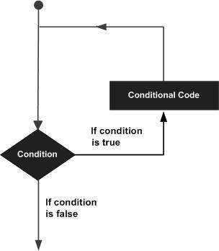

Slide 15
Looping | Nested Looping
For i in list: statement | For i in list: for j in list: statement

Slide 16
Function

Slide 17
def functionname(parameter1, parameter n):
function_string
return [expression]

Slide 18
Array vs List vs Tuple

Slide 19
Array
A bunch of data that have 1 data type.
Mutable.
List
A bunch of data that have different data type.
Mutable.
Tuple
A bunch of data that have different data type.
Immutable.

Slide 20
Example :
list1 = [‘physics’, ‘mathematics’, ‘chemistry’, 2000, 1999]
tup1 = (‘physics’, ‘mathematics’, ‘chemistry’, 2000, 1999)
arr1 = [‘physics’, ‘chemistry’, ‘mathematics’]

Slide 21
Dictionary

Slide 22
There is a key and value that separated with colon(:). It’s mutable.
Syntax :
Variable = {‘key’ : ‘value’}
Contoh :
dict1 = {‘DSI’ : ‘Data Science’}

Slide 23
Data Science

Slide 24
Numpy
Python library for manipulate array and matrix
Numpy is faster than list because data stored in one place for contiunity and more efficient.
2. Pandas
Python library for manipuate data visualization.

Slide 25
References and Special Thanks
https://www.tutorialspoint.com/python/index.htm
https://en.wikipedia.org/wiki/Python_(programming_language)

Slide 26
Assessment
Try to learn about python through online course. (w3schools, tutorialspoint, sololearn, udemy, udacity, etc). Free course recommended.
Practice the first until the end of the slide for this presentation.

